Slide 1

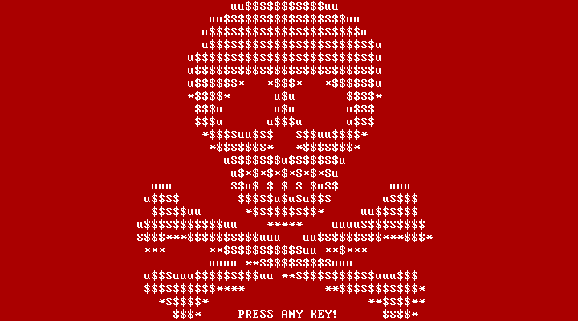
NotPetya Attack
2017
Team 3 :
Shreya, Fanxin, Angel, Linting, Yuxin

Slide 2
TABLE OF CONTENTS
01
02
03
04
05
ABOUT THE EVENT
What Happened
Impact
A high-level overview of what led to the events
A timeline of the events that occurred should be clearly outlined
Political, Financial & Economical, Social, Technology , Legal
Outcome
Conclusión
What changed after the events? Who was negatively impacted by the event?
A summary of what we discussed

Slide 3
01
ABOUT THE NOTPETYA ATTACK
2017 Ukraine Ransomware Attack

Slide 4

OVERVIEW OF THE EVENT
INITIAL APPEARANCE
TARGETING & SPREAD
GLOBAL IMPACT
Posed as ransomware but didn't allow decryption, aiming for disruption instead of ransom.
Primarily targeted Ukrainian entities using vulnerabilities in accounting software, phishing, and the EternalBlue exploit.
targeted Ukraine but also impacted global corporations like Maersk and Merck, causing billions in damages worldwide.

Slide 5
OVERVIEW OF THE EVENT
GEOPOLITICAL TENSION
HUMAN ELEMENT
LONG TERM CONSEQUENCE
Amid tensions, Ukraine blamed Russia for NotPetya, which Russia denied despite suspicions.
IT staff scrambled to manage damage, sending employees home uncertain.
Over $10 billion in global damages , spurred enhanced cyber defense and infrastructure awareness.

Slide 6
02
Timeline

Slide 7
Timeline
Outbreak/Initial Spread and Global Expansion
27 June, 2017
Commencement of Recovery Efforts
Early July, 2017
Identification of Major Corporate Victims
28 June, 2017
Attribution to State Sponsorship
Mid July, 2017
Recognition as a Wiper
Late June, 2017
Long-term Consequences and Policy Changes
Late July, 2017 and after

Slide 8
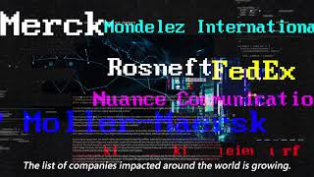

Slide 9
03
Holistic
Impact

Slide 10

Financial & Economical
Company’s losses: Businesses across sectors (banking, law, and manufacturing) experienced significant financial losses
Merck reported losses of around $670 million
Global Economic Slowdown:
Disruptions in critical infrastructure and supply chains.
Ukraine bank system; Maersk
Cybersecurity Investment:
Increased spending on security tools, training, and infrastructure upgrades.
Financial institution and Government
Notes:
Company’s losses: six power companies were hit. businesses across sectors like banking, law, and manufacturing experienced significant financial losses due to downtime, recovery efforts, and data breaches. For example, Pharmaceutical giant Merck reported losses of around $670 million, including lost sales and recovery costs.
Slowdown: All the banking system in Ukraine dead, ATM and credit card are unresponsive. The world largest shipping company, Maersk, fell silent. Their booking website was down; the port’s gate did not open. Hundred of thousands of tonnes of cargo cannot unload. Not only that, network of more than 500 offices across the world went offline. It took Maersk 2 month to rebuild the system.
Cybersecurity Investment:
The attack prompted many companies and governments to invest heavily in cybersecurity measures, included security tools, training, and infrastructure upgrades. Banks and other financial institutions, prime targets for cyberattacks. Many governments around the world allocated additional resources to national cybersecurity agencies to improve national preparedness for cyber threats.

Slide 11

Social
Lost in Trust:
Reduced reliance on digital services and Increased scrutiny of tech companies.
Data Loss:
Sensitive information loss like medical data. Increased risks of identity theft
Disruptions to Daily Life:
Healthcare, transportation, and panic among the public.
Notes:
Lost in trust: After the attack, many individuals have become hesitant to trust online services like banking, shopping, or healthcare portals due to concerns about data security.
Data Loss: the attack resulted in breaches of sensitive personal information like medical information, social security numbers or credit card details, it could have led to increased risks of identity theft.
Disruption to life: Ukraine is most affected country. one of the country’s major rail transport hubs lost its entire computer network. two major airport shut. Group of hospitals affected. Test result, medical records were lost, patient appointment were cancelled.

Slide 12
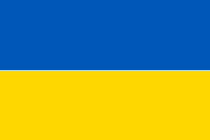
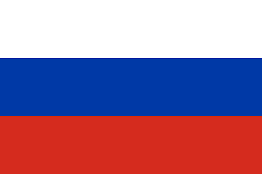
Political
Escalation of Geopolitical Tensions
Exacerbated existing geopolitical tensions, particularly between Ukraine and Russia.

Slide 13
Political
Reevaluation of National Security
There's been a shift towards integrating robust cybersecurity measures into defense and diplomatic frameworks to prevent future attacks and maintain international stability.
Emphasis on Cyber Defense
The incident catalyzed efforts to improve cyber defenses at the national level.

Slide 14
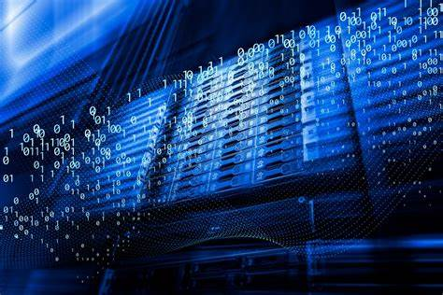
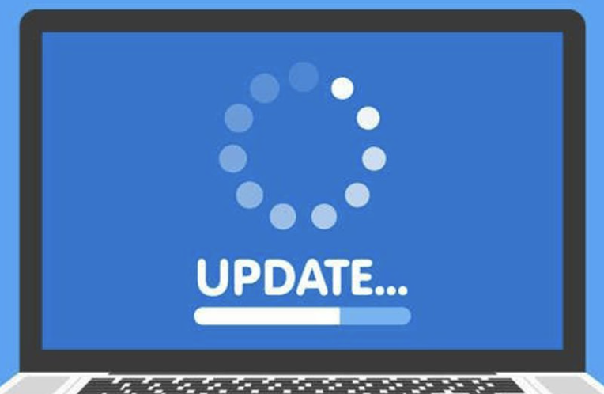
Technology
System Paralysis
Suffered severe damage, resulting in thousands of computers to become unusable, included Ukrainian government agencies, financial institutions, and multinational corporations.
2. Supply Chain Attack
Attackers leveraged the update mechanism of software companies to implant malicious code into software updates, thereby infecting a large number of users without their knowledge.

Slide 15
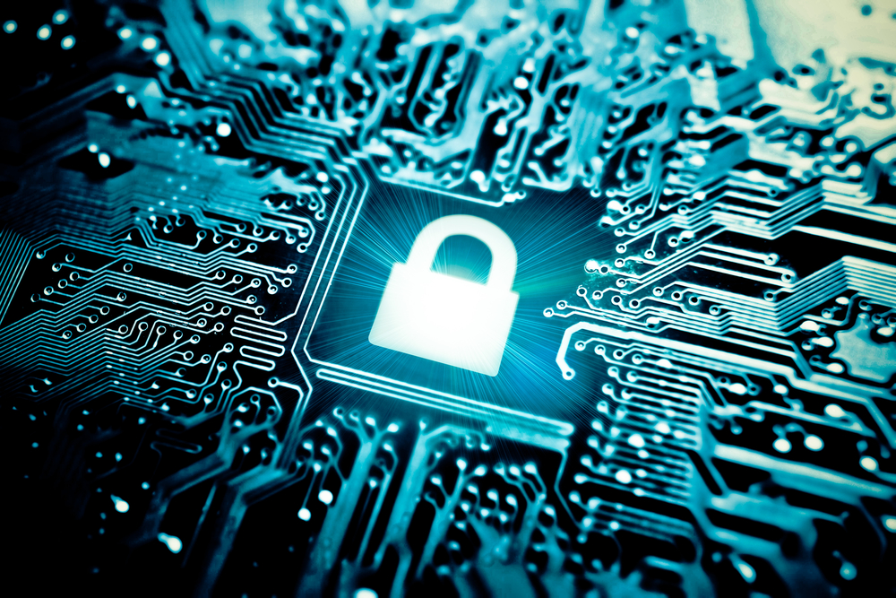

Technology
3. Data Encryption
Critical files and data were encrypted, rendering victims unable to access or recover them. This resulted in severe business disruption and losses.
4. Recovery Costs
The cost of restoring infected systems was extremely high. Victims had to expend significant time and resources to repair damaged systems.

Slide 16
Legal
Compliance Issues
Violated data protection laws and compliance requirements, like GDPR.
The General Data Protection Regulation (GDPR) aims to protect the personal data privacy and data security of EU citizens and residents.

Slide 17
Legal
Legal Litigation:
Affected organizations faced legal litigation from customers, partners, or regulatory bodies. These lawsuits demanded accountability.
Regulatory Penalties:
Affected organizations faced penalties from regulatory authorities. These penalties includes fines, data security audits, and other restrictive measures, further exacerbating financial and reputational losses.

Slide 18
04
Outcome

Slide 19

Who was negatively impacted？
Ukrainian Government:
government agencies, including the central bank and ministries, were directly targeted by the ransomware attacks.
Businesses in Ukraine:
experienced disruptions to their operations, particularly if they were unable to effectively recover from the cyber incidents.
Multinational Companies (i.e. Maersk, Merck ):
this event disrupts multinational companies with operations ties within this country, highlights the interconnected nature of the global economy.
End Users:
the attack disrupted essential services such as banking, transportation, and communication systems, endangering consumers and end users.

Slide 20
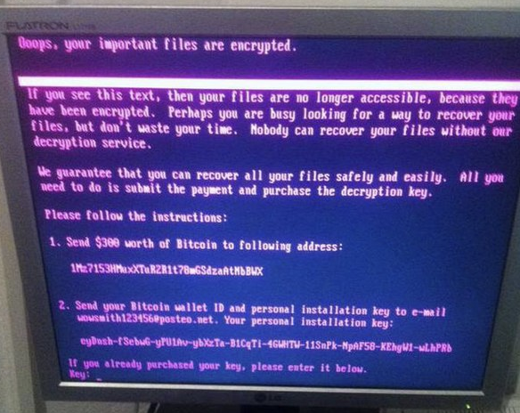
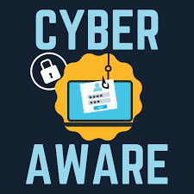
What Changed?
Awareness of Cybersecurity
Infrastructure Damage
Served as a wake-up call
Importance of cybersecurity
Prevent & Respond:
defense mechanisms, software updates, cybersecurity training
Substantial damage to critical infrastructure
Government agencies, Financial institutions, Transportation systems
Disrupts daily operations, caused financial losses, and eroded public trust

Slide 21
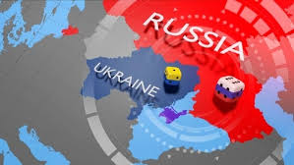
What Changed?
Geopolitical Tensions
Negative Reputation
The attribution of this attack to Russia contributed to existing tensions between Ukraine and Russia and strained relations between Russia and Western countries.
Organizations suffered reputational damage and erosion of trust among their stakeholders, highlights the importance of cybersecurity as a business priority.

Slide 22

CONCLUSIÓN
Unprecedented Impact
Cyber Vulnerability Exposed
Cybersecurity as a Priority
Global Response Triggered
Wake-Up Call
Strengthened International Cooperation

Slide 23
THANK YOU !!

